Slide 1

QML Gradient Methods
Numerical and analytical optimization methods

Slide 2
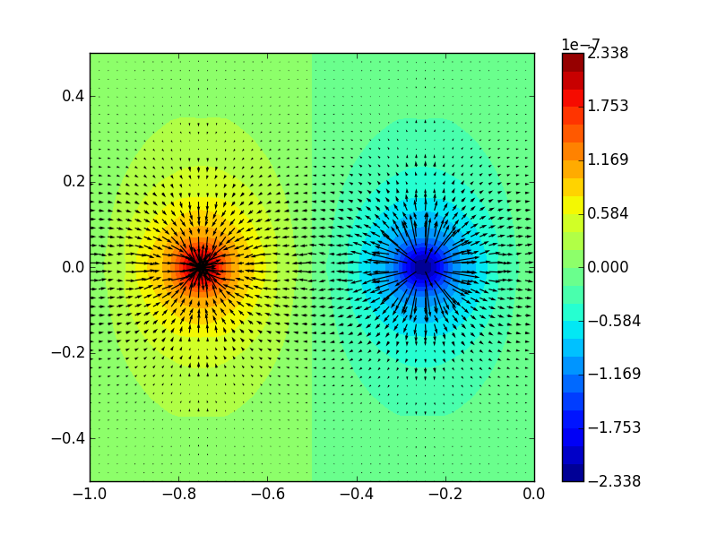

The Gradient
The rate of change with respect to each parameter
Essentially the slope in vector calculus
$∇f\left(x,y,z\right)=\frac{∂f}{∂x}\hat{i}+\frac{∂f}{∂y}\hat{j}+\frac{∂f}{∂z}\hat{k}$

Slide 3
Types of QML Gradients
Parameter Shift
Linear Combination
Finite Difference
Natural Gradient

Slide 4

Parameter Shift
Utilizes the idea that our function is just a series of unitaries
If we just shift the input parameter, we can get the gradient
$∇_{θ}f\left(\vec{θ}\right)=f\left({\vec{θ}}_{1}\right)−f({\vec{θ}}_{2})$
Is the default gradient for Qiskit and Pennylane as it is computationally efficient and still analytical

Slide 5


Linear Combination
$U\left(ω\right)=e^{iM\left(ω\right)}$ where $M\left(ω\right)=\sum_{p}{m_{p}\left(ω\right)}h_{p}$ and $h_{p}$ is any of the Pauli rotation gates
Essentially, any unitary can be written as the exponentiated weighted sum of Pauli matrices
Comparable to parameter shift, still analytical, but causes some errors in Qiskit using default variational circuits

Slide 6

Finite Differences
$\frac{∂f\left(x,y,z\right)}{∂x}≈\frac{f\left(x+δx\right)−f\left(x\right)}{δx}$
Numerical gradient method
Very computationally efficient but very sensitive to noise

Slide 7

Natural Gradient
Uses fisher information to transform the steepest descent in parameter space to steepest descent in distribution space
Has the fastest descent usually but is much more computationally intense
$$θ_{t+1}=θ_{t}−ηF^{−1}∇L\left(θ\right)$$
Where $L(θ)$ is the loss function, $η$ is the learning rate, $F^{−1}$ is the inverse fisher information matrix

Slide 8
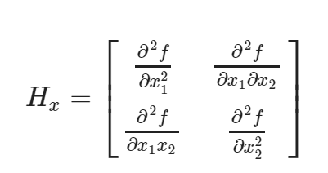

Hessians
Matrix of second derivatives
Gives information about curvature
Can be used to determine proximity to minima to determine learning rate
Can also be used to compute a second order numerical gradient descent method

Slide 9
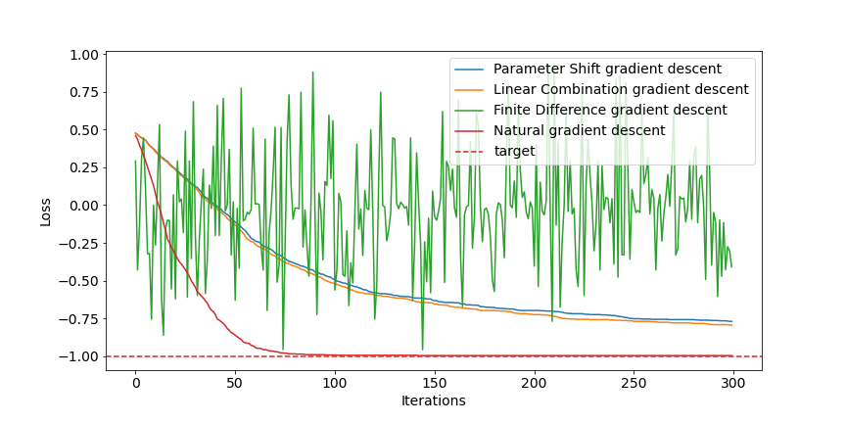
Gradient optimization using IQP ansatz

Slide 10
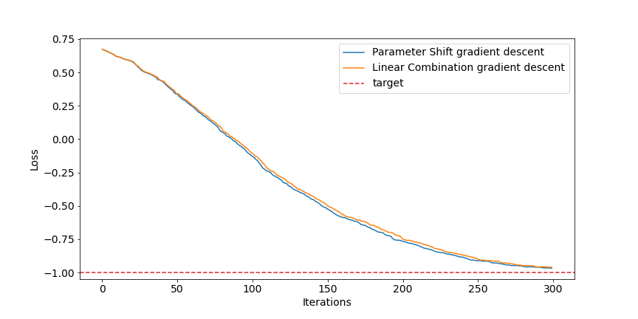
Gradient optimization using EfficientSU2 ansatz

Slide 11

Questions

